Slide 1
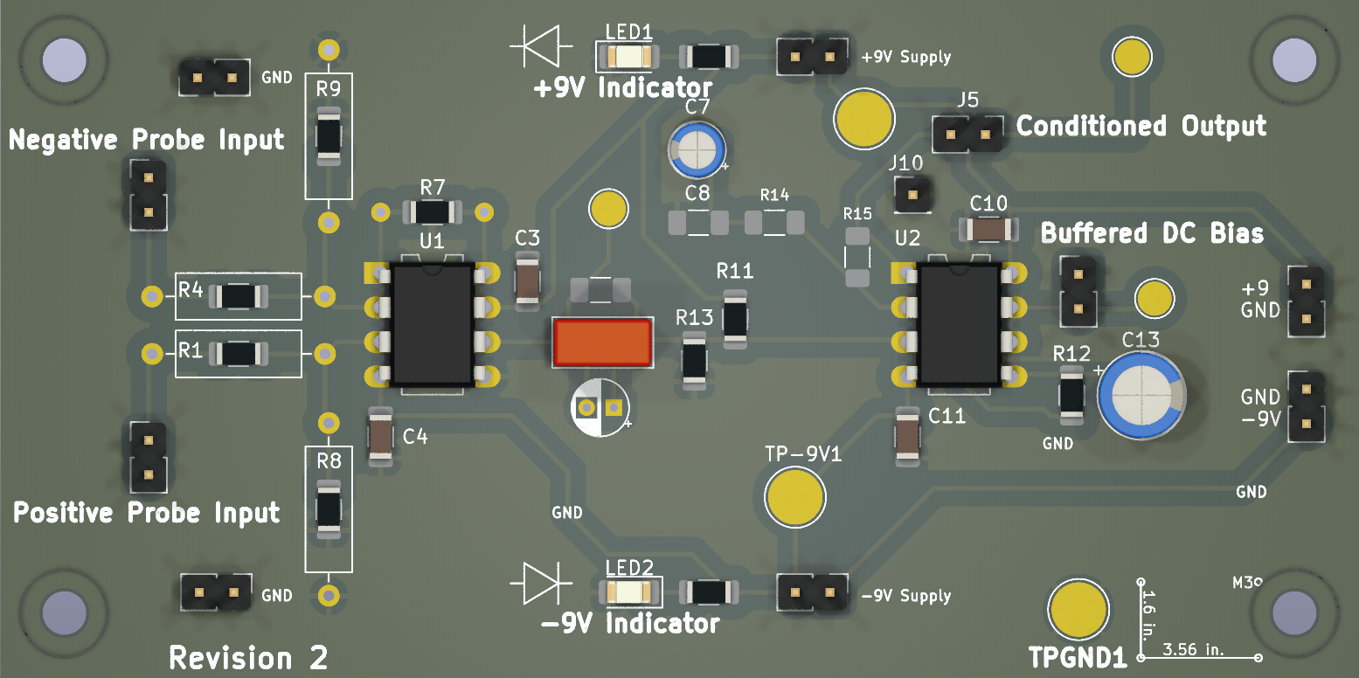
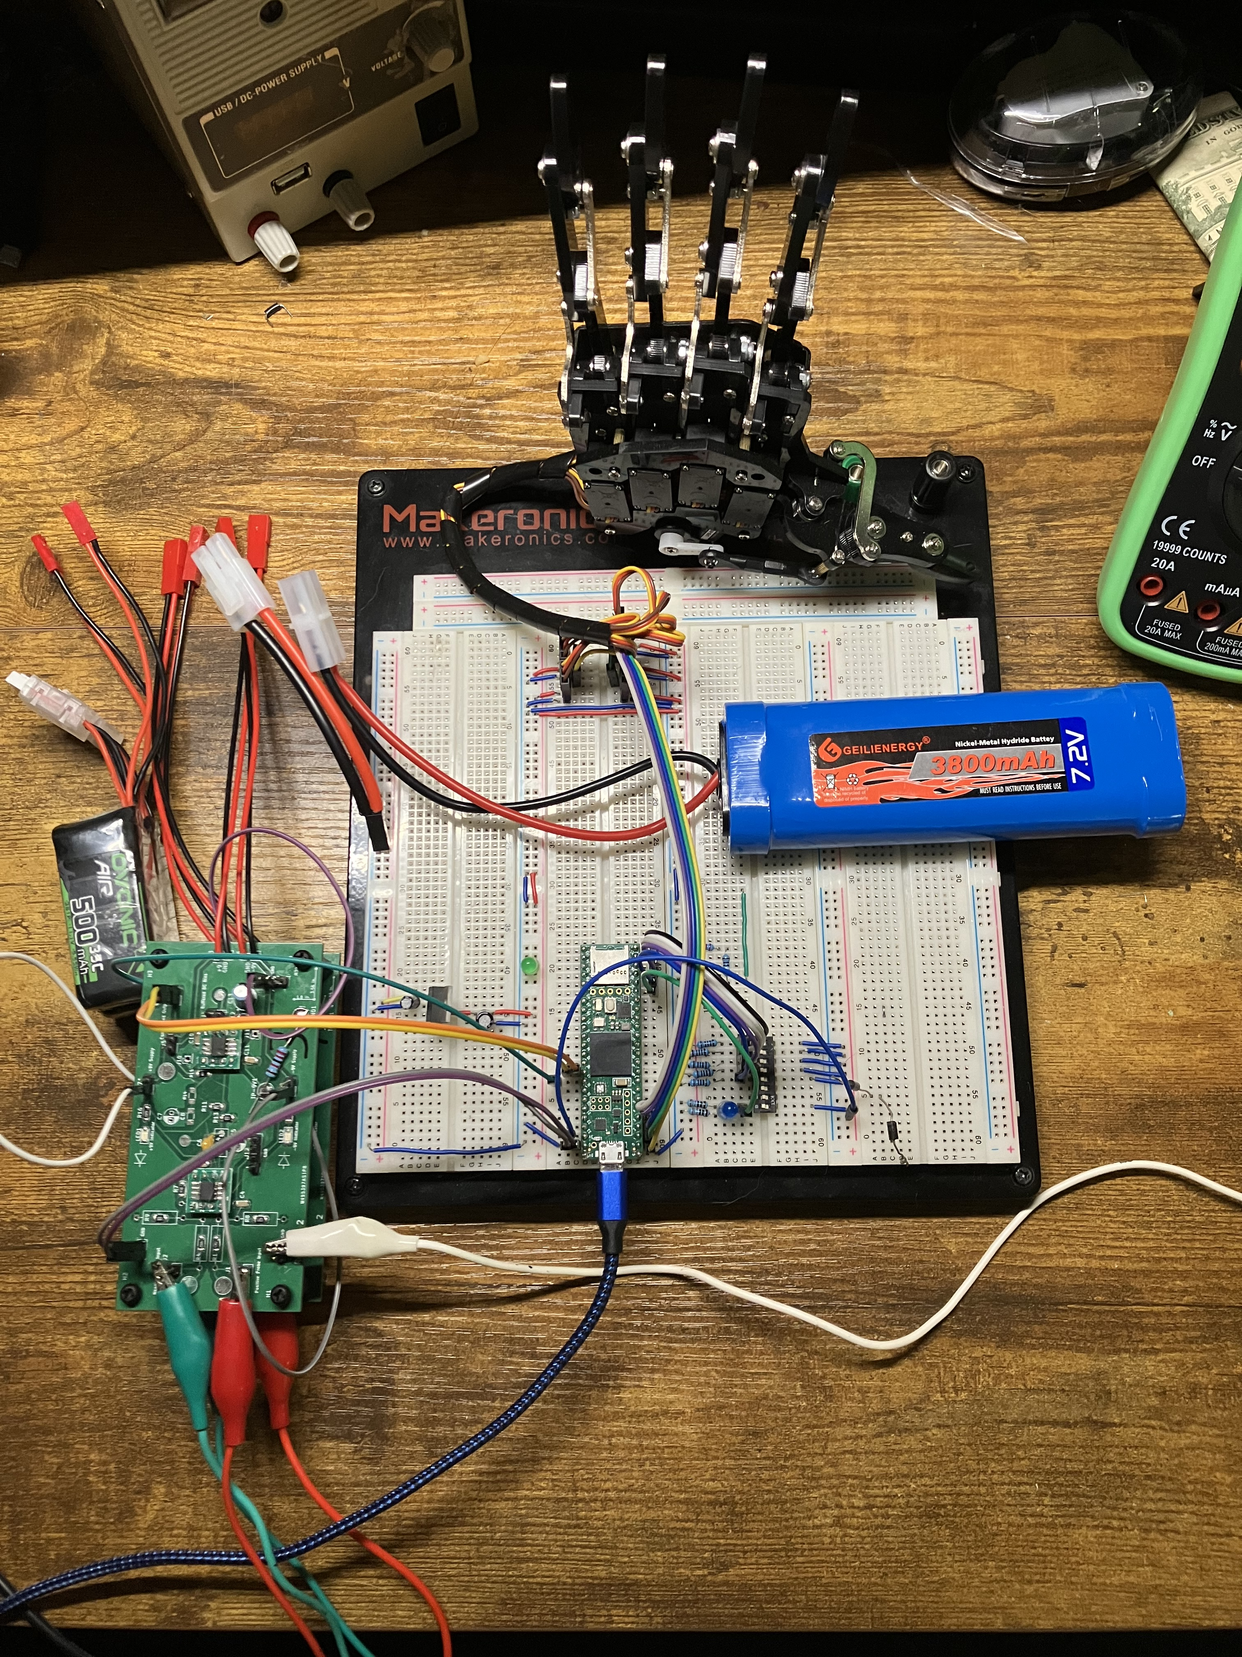
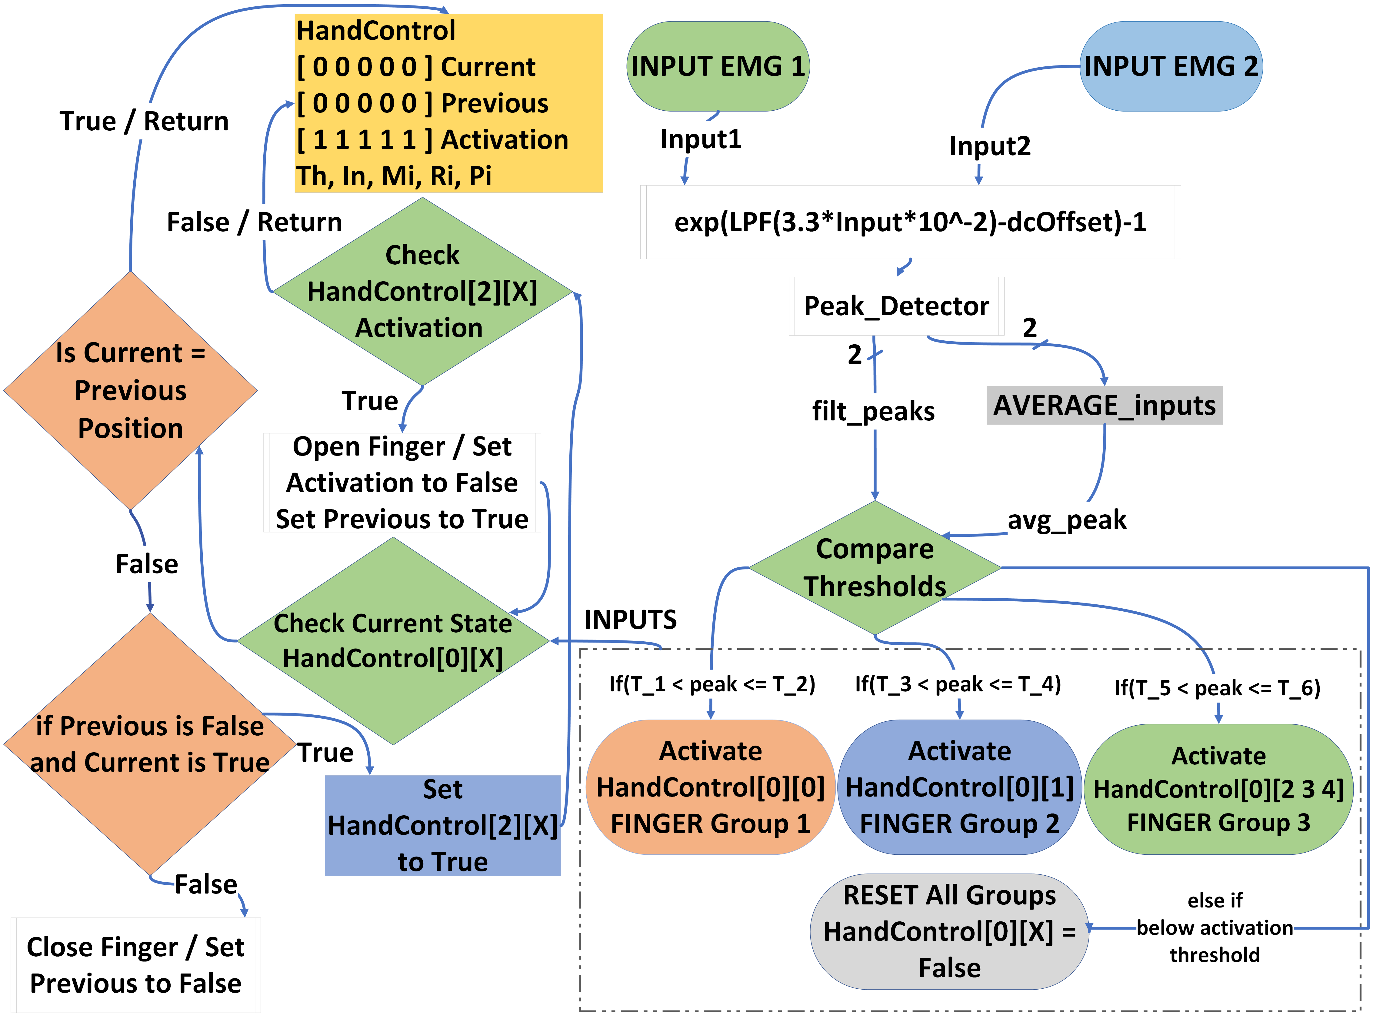
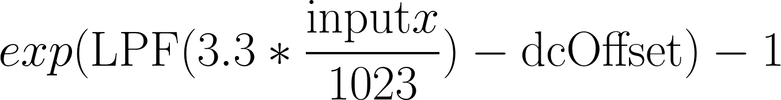
Motorized Robotic Hand Controlled by Surface Electromyography (sEMG)
Authors: Jay E. Bernstein, David J. Mora, Juan R. Ortiz; Advised by Dr. Norali Pernalete
Block Diagram
Abstract
The objective of this project was to collect muscle signals from skin level probes, so that a user could move their physical hand to control a remote, motorized hand. This required consideration of how the signals should be processed, while also solving unique physical challenges. The human body acts as a large antenna for interfering signals, and coupled with thick skin interfering with measured nervous system impulses, specialized hardware was required. Because this is a medical device, considerations of safety had to be made as well. Commercial products were used to streamline the design process, a powerful microcontroller with DSP capability was chosen early to reduce processing limitations, and discrete instrumentation amplifiers were used to guarantee high gain and low signal distortion. The final product is cheap, can acquire tens of microvolts, and has almost no common mode interference. Multiple digital methods were created to determine which finger was active, centered around signal amplitude as opposed to frequency analysis. This product fully meets the hardware demands of the highly sensitive realm of bio-informatics with absolutely no invasive procedures or special environments necessary.
MCU (Teensy 4.1)
Amplifier
Capture 1000 Samples at 40kHz with ADC
Protected Inputs to Instrumentation Amplifier IC
sEMG Probes
Normalize, Rectify, and Amplify ADC Input
Robotic Hand
AC Coupled and Buffered Output
Finger Detection Algorithm
Figure 2: Block Diagram showing the acquisition and processing chain for the EMG signals. Muscle activations are sent into the amplifier, which is conditioned so that the onboard ADC of the Teensy can acquire it properly. A 40kHz periodic sample is taken, processed slightly, and used to make a decision on the activation of the robotic hand.
Figure 1: A render of the revision 2 amplifier PCB, altered for clarity. Large silkscreen text is used to emphasize separate regions of the board.
Hardware/Software Overview
The hardware required to implement the current version includes the Teensy 4.1, a development board with an ARM Cortex-M7 600MHz MCU, which has a DSP instruction set. Three batteries are used to power the system, although it could be powered with a minimum of two. Two matched Li-ion 11.1V batteries are used to power the positive and negative rails of the amplifier, and a 7.4V NiMh battery is used to power the MCU and servos in the hand, with conditioning from a 7805. The hand used is a COTS robotic hand sold on Amazon, with 9g 6V anti-blocking servos. The amplifier consists of three stages. The front-end has high value resistors to reduce shock hazard for the user, as well as bias current grounding resistors to increase the performance of the instrumentation amplifier. The amplifier is configured for 2000x gain. The middle stage is AC coupled to a resistor divider, which sets the dc midpoint of the signal at approximately 2 volts. This is acquired by two separate circuits attached to a single LF353. One op amp is used as a signal buffer stage, which is layed out so that if additional gain in the buffer stage is required, the circuit can be easily modified. The other integrated op amp is used as a low pass filter which outputs the dc midpoint value of the conditioned signal, to improve processing and check for issues with the circuitry.
The software was developed in Arduino IDE using built in libraries from Arduino and Teensy. The signal gets acquired by the onboard ADC of the Teensy set to 10 bits and 4.5us acquisition times per sample. At the beginning of the loop, 1000 samples are acquired at 40kHz, equal to a window of 25ms. These input go into a first order chebyshev low pass filter, and the exponential gain is calculated. The highest value from each probe in that window is found, and considered the peak. These peaks are only reset every 250ms, which was found to be the maximum time between Motor Unit Action Potentials (MUAPs). There are two methods to determine which finger/muscle is correlated to the peak signals. The first method, as illustrated by Figure 5 and the control diagram in Figure 7, is determining if the peak is within the bounds of a known signal. If it is below the max, and above the minimum, the finger group is considered active by the software and hand control begins. The second method, as illustrated by Figure 4, is using the two peak amplitudes as x and y dimensions of a vector. By calculating the distance between that vector, and the known states of the hand, the software will consider the shortest distance to indicate that a specific finger group is active. Hand control can be sophisticated, because the software needs to track the position of each servo and create a digital memory of how the hand moves. The control is illustrated in Figure 7. If a finger is considered active, it needs to move to a new state. Sometimes, it is already in that state, in which case a new movement needs to be avoided. When the movement concludes, the software reports that it is finished, and the finger will be considered inactive again until the detection algorithm reports a new movement.
Recorded Vs Processed Signal From Probe
Clench
Sensor 2 Processed Amplitude
Ring
Index
Measured Point
Middle
Thumb
Pinky
Open Hand
Sensor 1 Processed Amplitude
Threshold 1
Figure 3: Picture of prototype project. Pictured bottom left: stacked amplifier PCBs. Middle left: Li-Ion batteries. Top center: robotic hand and wiring harness. Middle right: NiMh battery. Bottom center: Teensy 4.1.
Threshold 2
Threshold 3
Conclusion
This project faced multiple challenges to reach its current state. The greatest challenge was common mode interference, which stemmed from implementing our amplifiers using multiple components, and on breadboards. The first idea was to implement a 60Hz filter, which ultimately removed important signals and didn’t improve the acquired signal. This was solved with the first revision of the PCB amplifier which improved isolation and controlled ground loops, and performance was further refined in the second revision. The second challenge was distinguishing between signals. While the hardware amplifies microvolts to readable amplitudes, the smaller readings from the thumb and pinky, for example, were hard to differentiate in software. The current product is able to reliably acquire signals, detect small and large muscular pulses, and react to large impulses by opening and closing the motorized hand. We could successfully detect multiple fingers, but could not account for edge cases or unexpected movements, making it unacceptably unreliable. A few methods were theorized to increase reliability but didn’t get tested. The first would be to increase the number of probes placed, which would help differentiate which signal was active. A frequency based analysis of the input signals has potential, but the implementation of that is outside of the scope of the project members expertise [2]. If this project were to be continued, a more detailed analysis of the signals in the frequency domain would be conducted to determine if they would improve the final product, and a software method to automatically calibrate the hand trigger determinations would enter the final product.
Figure 4 (top): A demonstrative diagram showing how a distance based trigger determination is made. Vectors for predetermined actions are decided on by manual configuration or software. The scalar distance between the measurement and each preset is taken, and the action with the smallest distance to the measured vector is activated.
Figure 5 (bottom): Example of different signal amplitudes to show how threshold based triggers are determined. Each line color represents a different muscle group being measured from the same location by the same hardware. Shaded regions indicate the voltage levels being monitored.
Figure 6 (top): Graph displaying the output of the amplifier in blue, and the processed signal in orange. The rectification is the most prominent component, but digital filtering and gain also occur.
Figure 7 (bottom): Signal processing and control flow for amplitude threshold based motor control.
References
[1] Michael Haidar, Jason Hwang, and Srikrishnaa Vadivel, “EMG Robotic Hand,” Cornell University, 2016. Accessed: Apr. 21, 2024. [Online]. Available: https://people.ece.cornell.edu/land/courses/ece4760/FinalProjects/f2016/mh2298_jyh37_sv376/mh2298_jyh37_sv376/mh2298_jyh37_sv376/index.html
[2] Z. Li, Q. Ding, X. Zhao, J. Han and G. Liu, "Wavelet-based detection on MUAPs decomposed from sEMG under different levels of muscle isometric contraction," 2017 IEEE International Conference on Robotics and Biomimetics (ROBIO), Macau, Macao, 2017, pp. 965-970, doi: 10.1109/ROBIO.2017.8324542.
6mm 8mm 10mm 20mm 30mm. 32Point = 0.5 inch High

Slide 2
Clench
Open
Sensor 2 Processed Amplitude
Ring
Index
Measured Point
Middle
Open
Thumb
Pinky
Open Hand
Sensor 1 Processed Amplitude
exp(LPF(3.3*Input*2⁻¹⁰)-dcoffset) - 1
Table 2 (bottom) displays the difference in frequency response of the two revisions. The difference in high frequency performance is due to changing the instrumentation amplifier IC from INA823 to INA828.

